Slide 1
Risk and Insurance in Village India
Robert Townsend Econometrica 62 1994, 539-591

Slide 2
Questions
How good are risk-bearing institutions in insuring villagers in South India against erratic rainfall, crop and human disease risks and sharp income fluctuations?
Method: Rather than look at each institution separately, Townsend examines them collectively in G.E framework.

Slide 3
Risk Reducing Institutions
Diversification of farmholdings by plot, crop
Grain storage
Purchases and sales of assets: animals, land
Credit
Gifts and transfers within family networks

Slide 4
Key Theory: Wilson 1968, Diamond 1967, Mace 1991
Under assumptions (a) Preferences are time separable (b) Preferences reflect weak risk aversion, ( c) everyone has same discount rate and common information, an optimal allocation of risk-bearing of single good in stochastic environment implies that all individual consumptions are determined by aggregate consumption
This result holds for wide variety of technologies

Slide 5
Two individual case
One risk averse farmer
One risk-neutral insurer
W/o enforcement or information problems, the risk averse farmer can be fully insured, such that his consumption would depend on permanent income, not his own income of that year. With many agents growing different crops and co-insuring , the individual’s consumption would depend on the aggregate income

Slide 6
Objective
Does not test for overall efficiency, just full risk-sharing.
Does so in ICRISAT Villages of South India (semi-arid tropics)

Slide 7
ICRISAT Villages and Data
3 villages with wide variety of crops
Detailed data on each plot: inputs, outputs and by-products, soil quality varies by plot
Different seasons Kharif, rabi
While they diversify crops, plots etc., they do not completely diversify, suggesting the importance of other relevant risk reducing mechanisms
Profits and incomes may be subject to measurement error, as are labor times of children, women. Hence full income constraints are for adult males only

Slide 8
In each village
The four principal components (sources of income) :crops, livestock, labor, trade and handicrafts vary in importance across villages and size of landholder
Livestock income the least risky, labor income the most risky

Slide 9
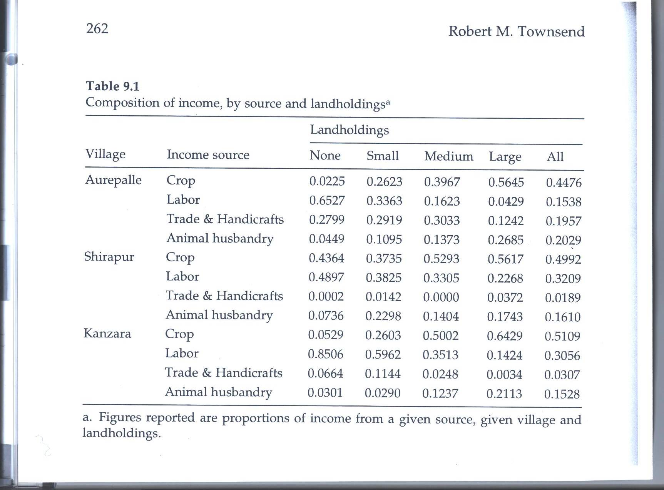

Slide 10
Next look at the correlation of HH income with aggregate village income
Note from Table 9.2 the relatively low correlations of the different components of income with aggregate incomes, except for Kanzar a

Slide 11
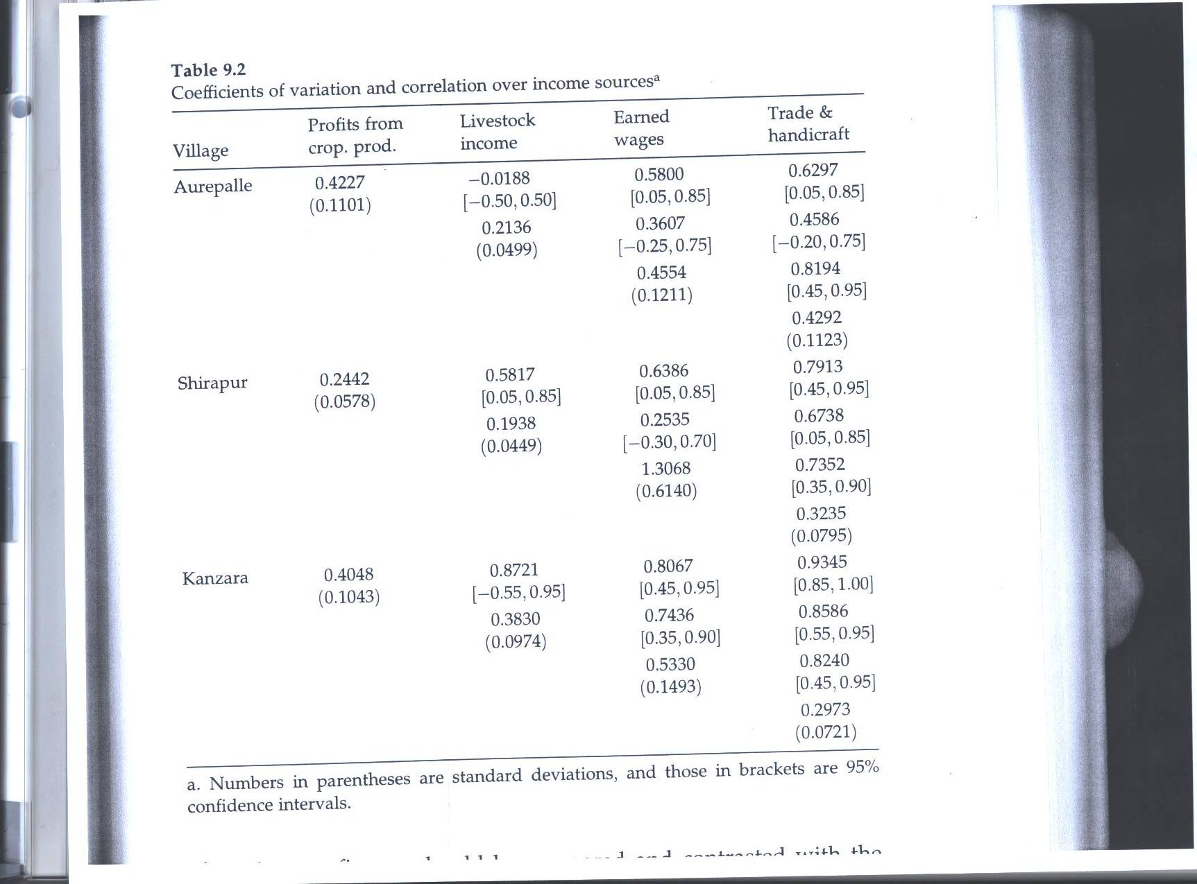

Slide 12
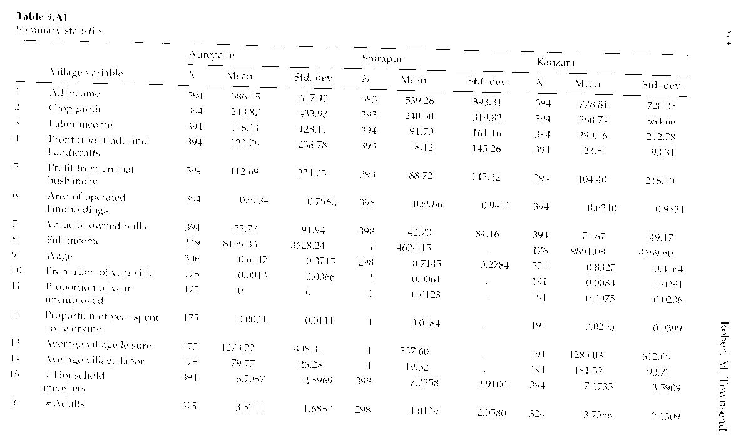
Descriptive Statistics

Slide 13
Note that over time, individual household incomes do not move very closely with aggregate village income
Figure 9.1
This is especially true for those of lower income rank

Slide 14
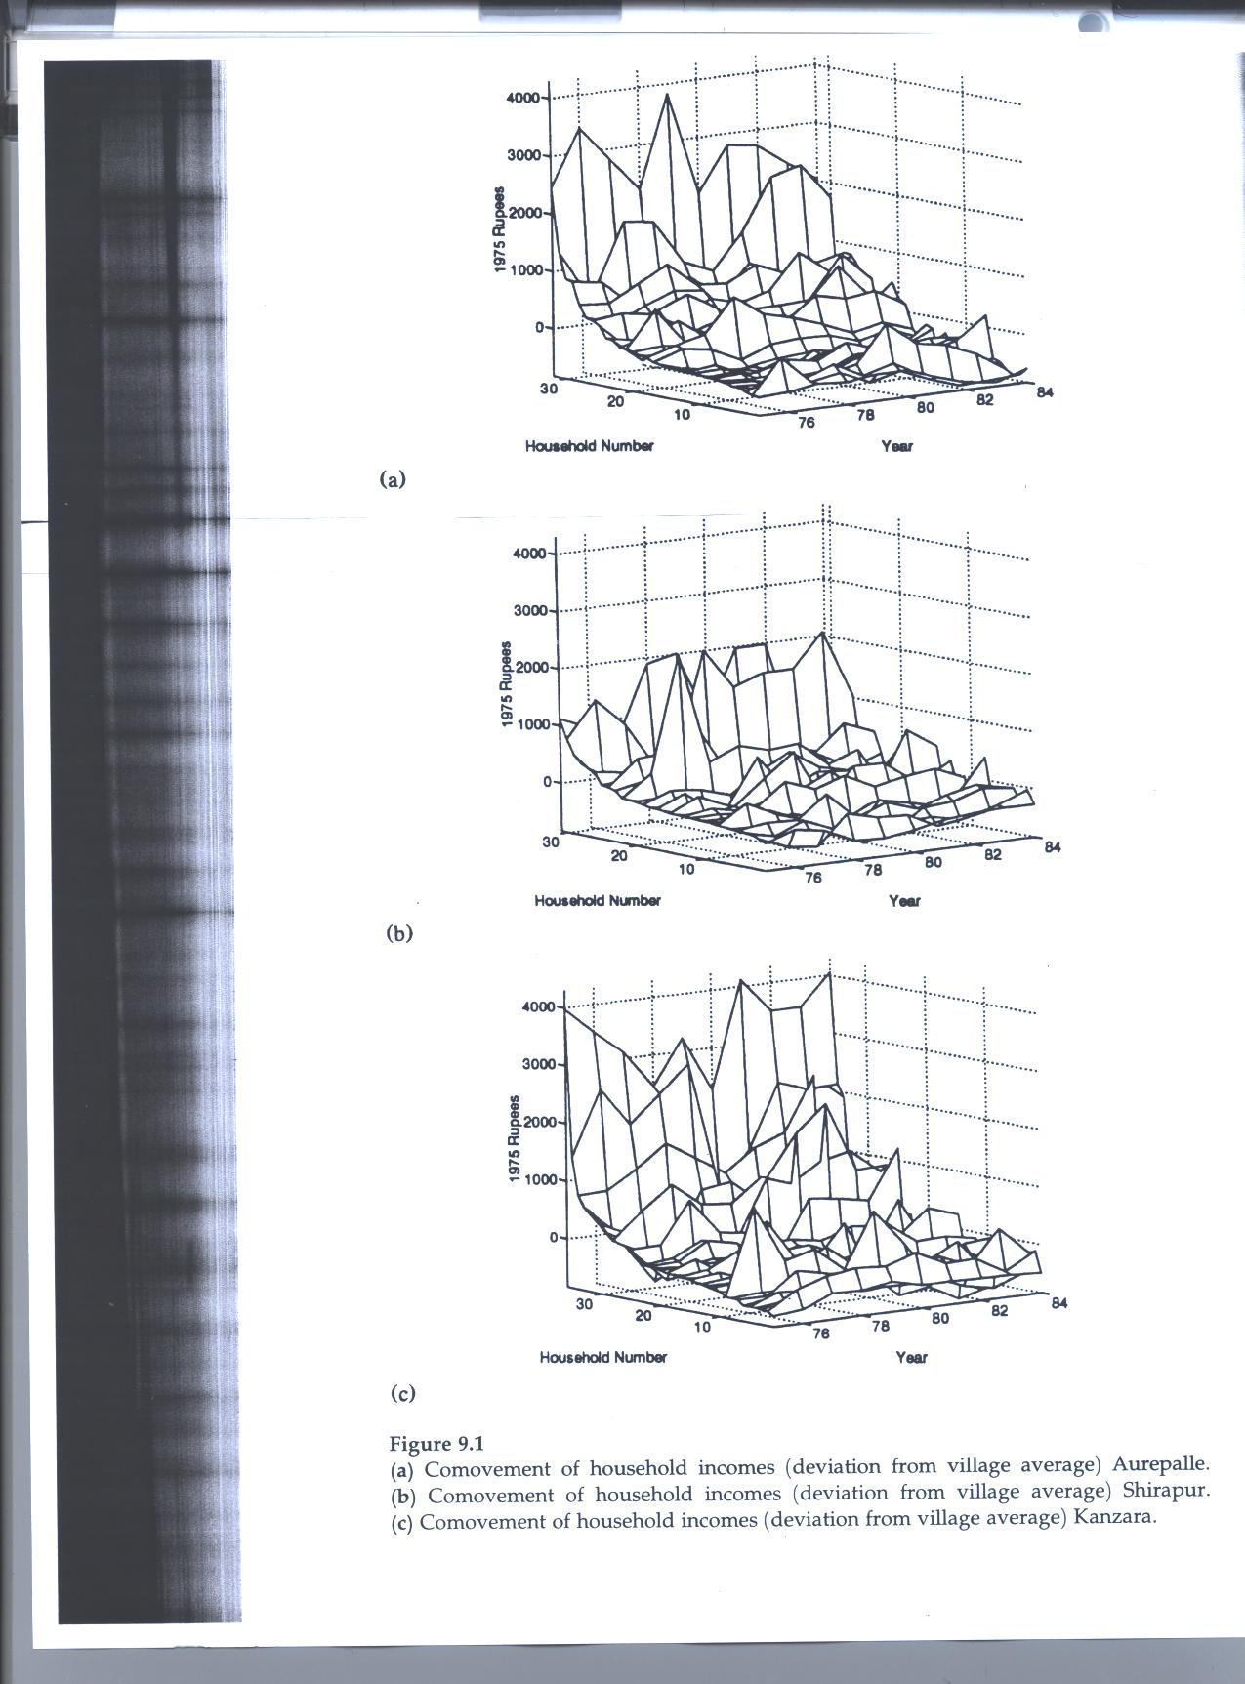

Slide 15
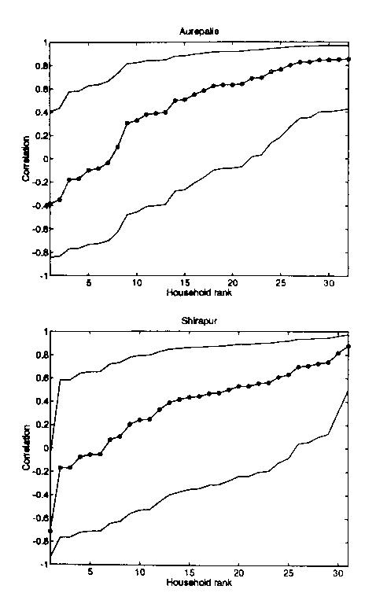
Correlation coefficients of HH with aggregate village income

Slide 16
Very different picture for consumption
In this case the co-movement of hh consumption and village consumption is rather close

Slide 17
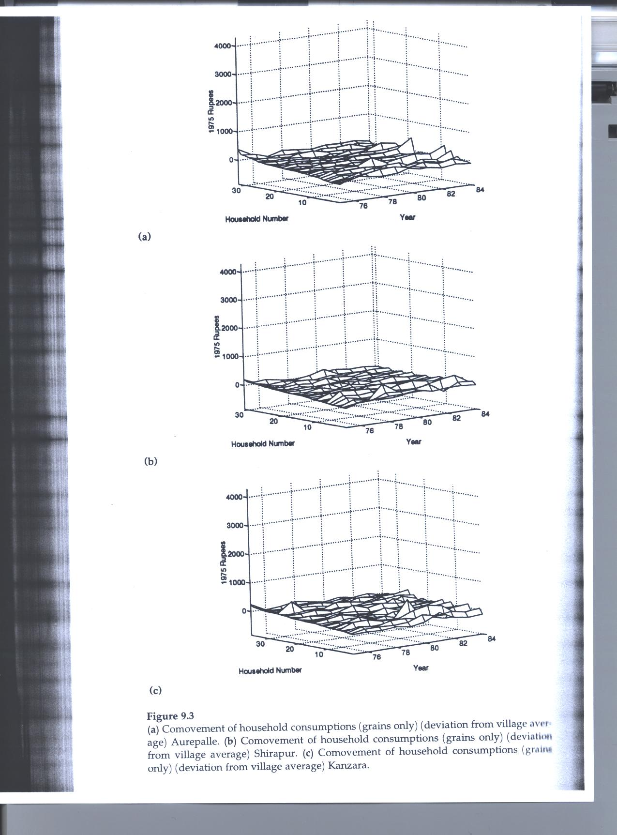

Slide 18
Utility Maximization
Separable into Consumption c and leisure

Slide 19
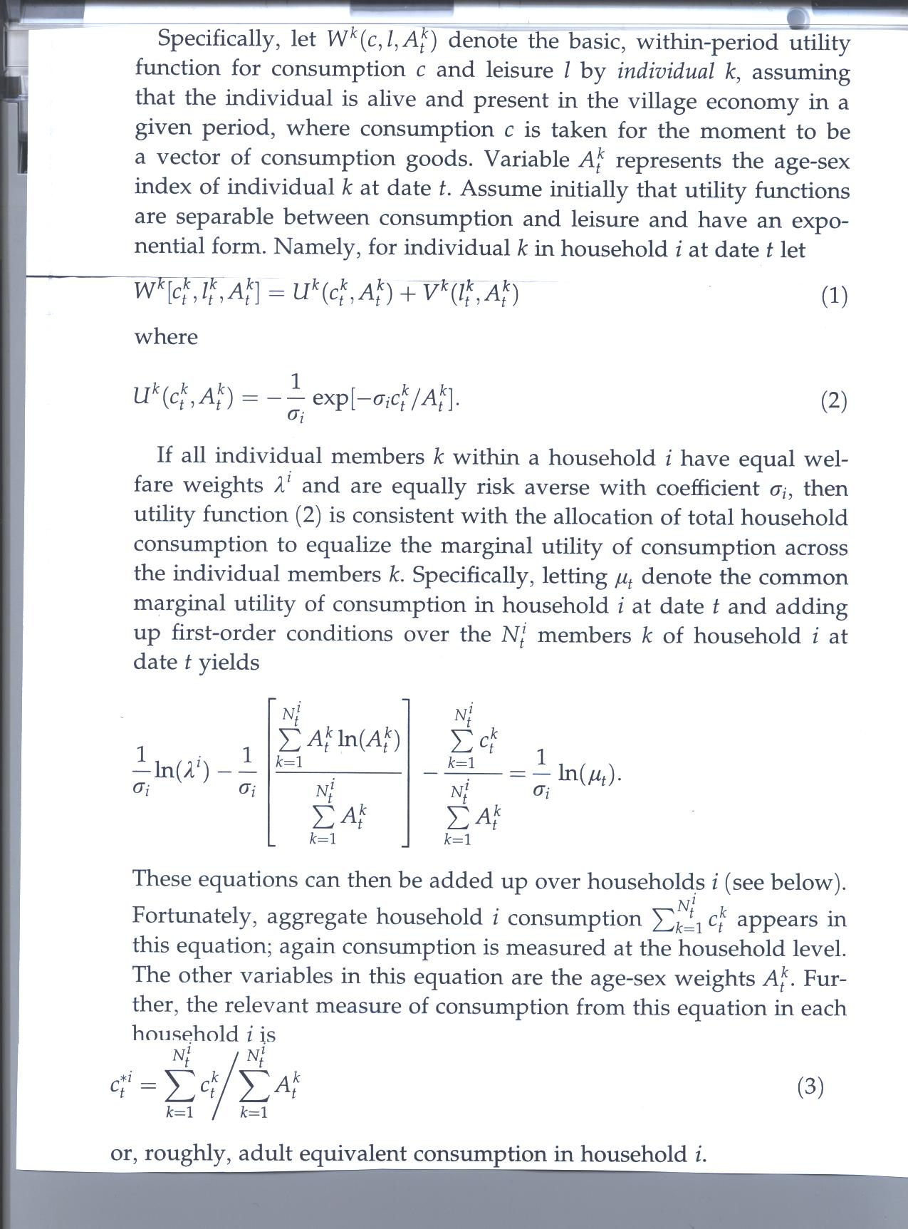

Slide 20
Measurement of hh Consumption
Somewhat flawed since not measured for all items for each year
Hence uses both
  grain consumption for all 10 years
  Total consumption for 1976-81

Slide 21
Dynamic Programming problem
Let c_{t}^{k}(h_{t}), l_{t}^{k}(h_{t}) be consumption, leisure assigned to individual k, given both contemporary and past states of nature ε₁ε₂…ε_{t}
Σ_{t=1}^{T}β^{t} Σ_{ht} prob (h_{t}) W^{k}[c_{t}^{k}(h_{t}), l_{t}^{k}(h_{t}),A_{t}^{k} ]
c_{t}^{k}(h_{t})>=0, 0< l_{t}^{k}(h_{t}) <time endowment
Let λ^{k} be programming weight associated with individual k and Σ λ_{k=1}^{M}λ^{k}= 1 where M is no. of individuals ever or potentially alive in village
Σ_{k=1}^{M}λ^{k} Σ_{t=1}^{T}β^{t} Σ_{ht} prob (h_{t}) W^{k}[c_{t}^{k}(h_{t}), l_{t}^{k}(h_{t}),A_{t}^{k} ]
i.e. max sum of weighted utilities s.t. feasibility constraints on cons., leisure

Slide 22
Impose various simplifying assumptions
Utility functions separable
All individuals k have same weights and risk aversion
If so:
C_{t}*^{j} = α^{j} +β^{j}cbar_{t} +δ^{j}Abar_{t}^{j} +ξ^{j}X^{j} +u_{t}^{j}
Where c* = adult equivalent consumption in hh and cbar is that average for village as a whole in a given year t

Slide 23
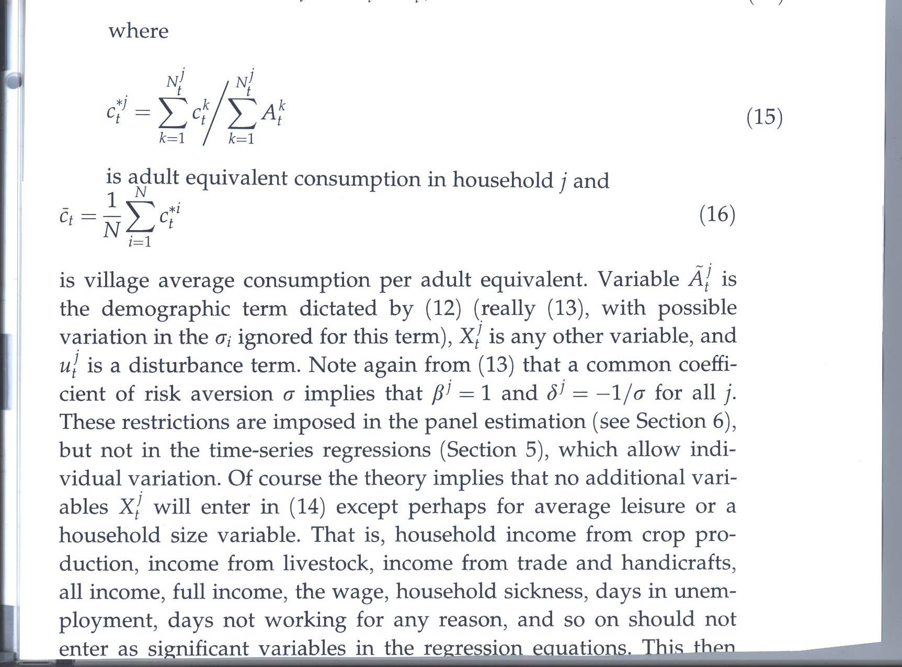

Slide 24
Estimates of β by village for different measures of consumption
Row 1 sum of all food, edible oil, clothing 1975-84
Row 2 grain cons for all years
Row 3 same as 1 but for 1976-81 only

Slide 25
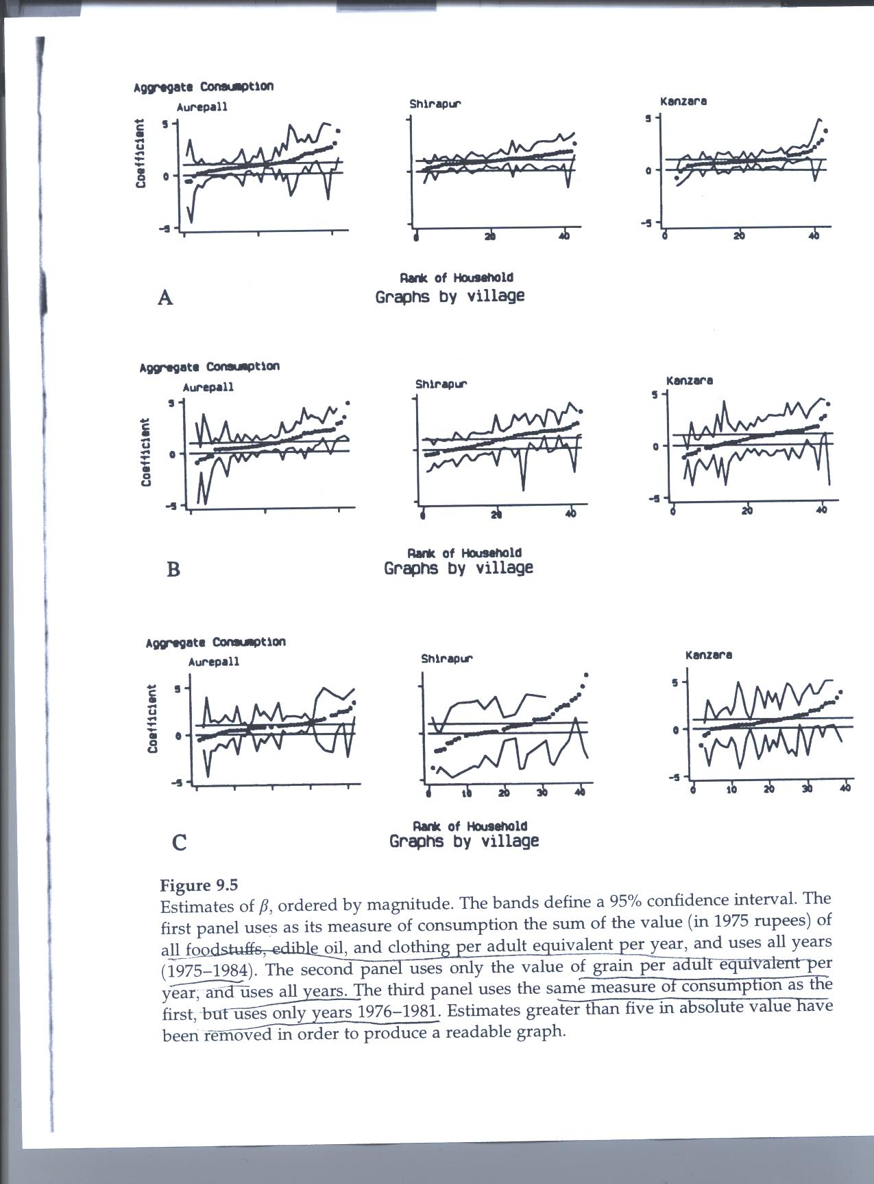

Slide 26
Findings Fig, 9.5
In panel A, the values are near 1 and significantly different than 0
In panel B with grain only the fit is less good as in panel C with fewer observations

Slide 27
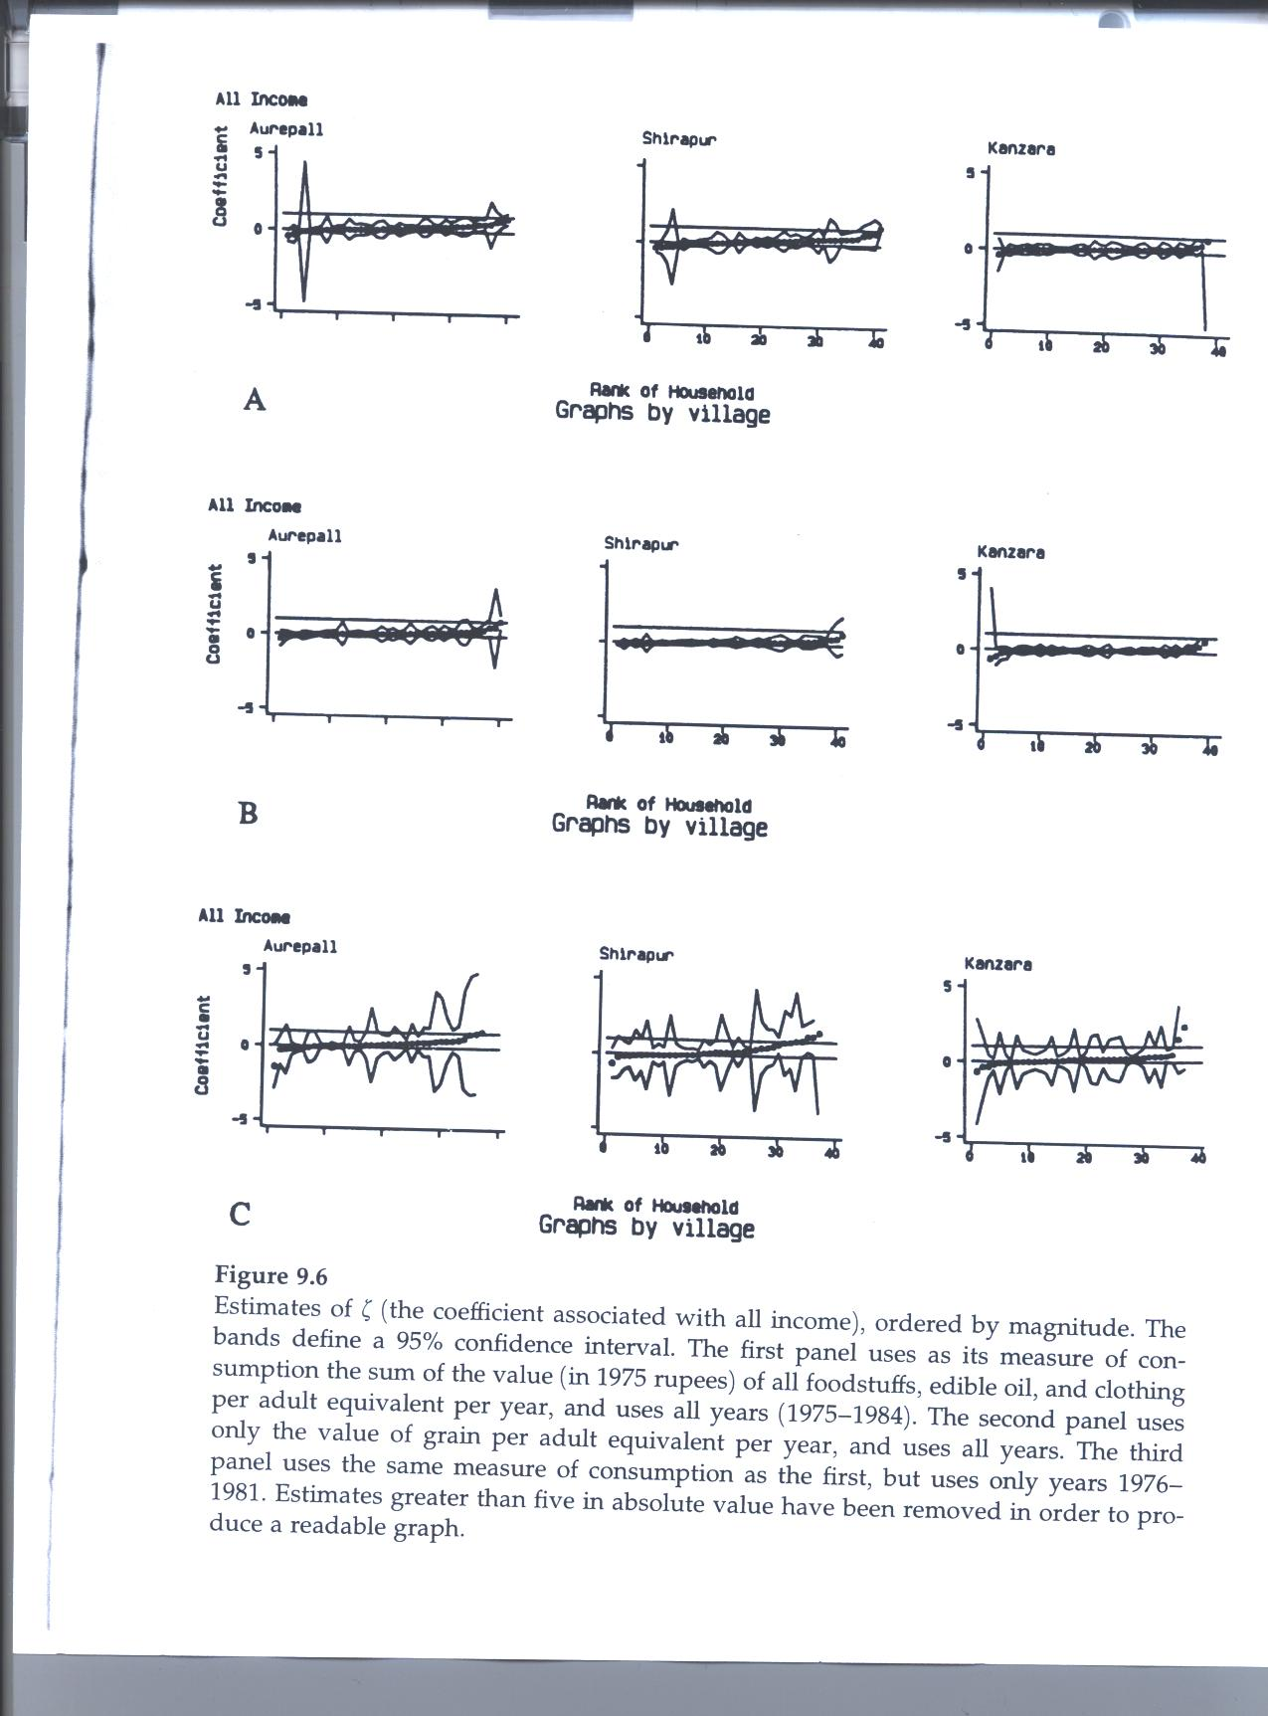

Slide 28
Findings for ξ in Fig 9.6
In all three panels the estimates center around 0
See also Table 9.3b for average and s.d. of this regression coefficient

Slide 29
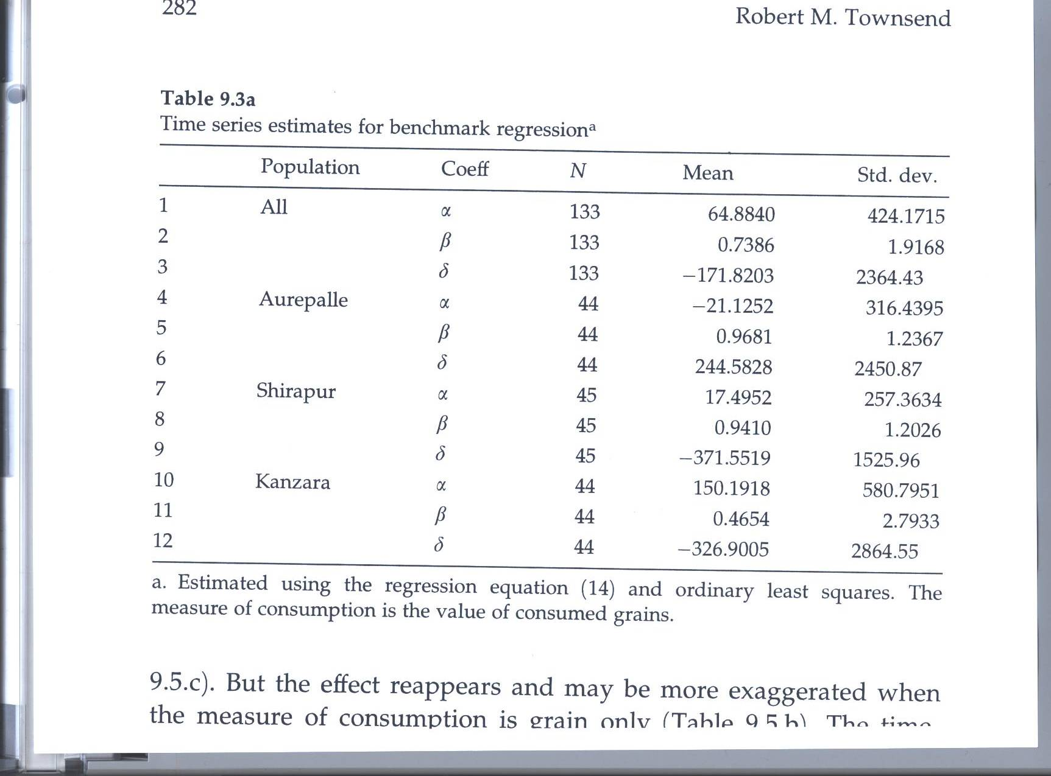

Slide 30
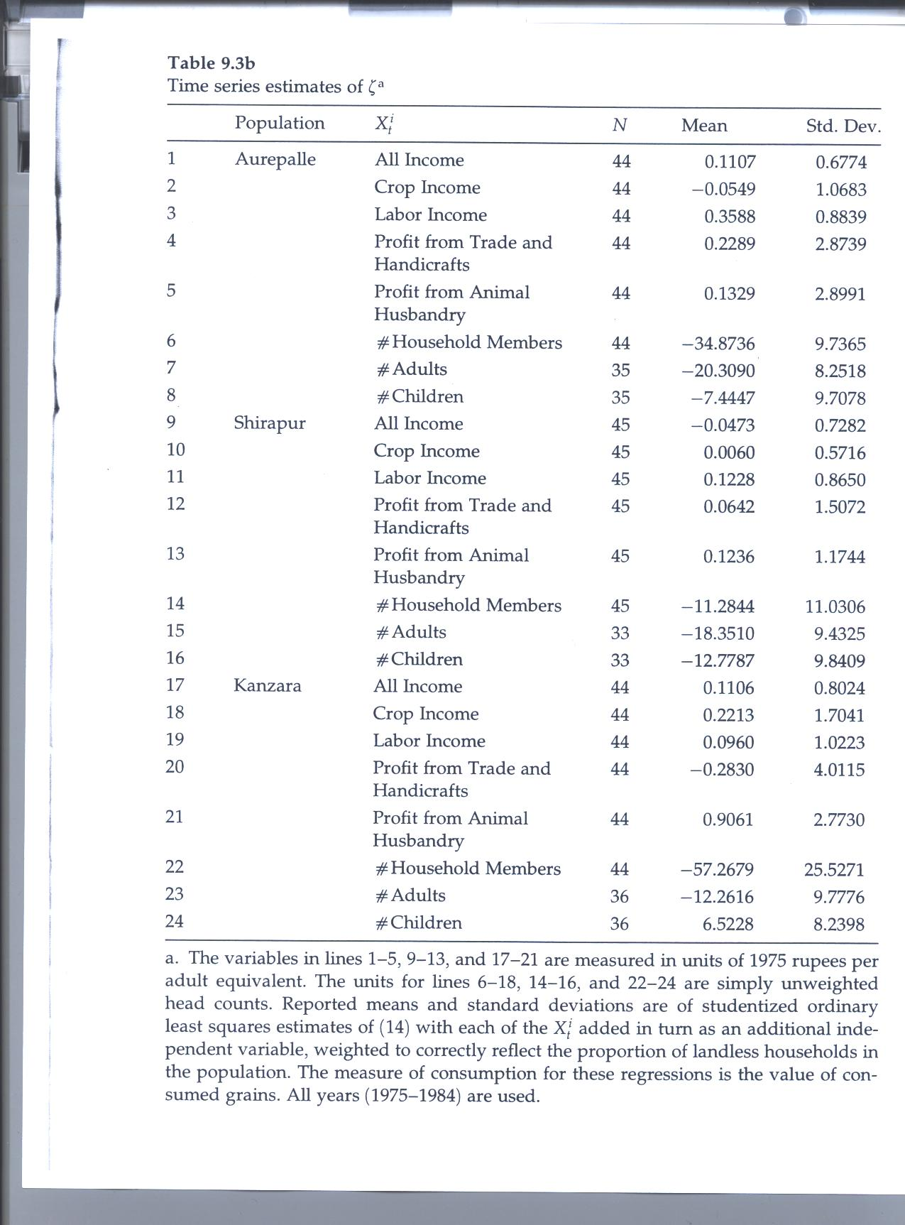

Slide 31
Formal testing of β = 0,1
Table 9.4
Tends to reject β = 0, accept β =1
Testing for ξ = 0,1 in Table 9.5 Tends to accept ξ = 0 and reject ξ = 1

Slide 32
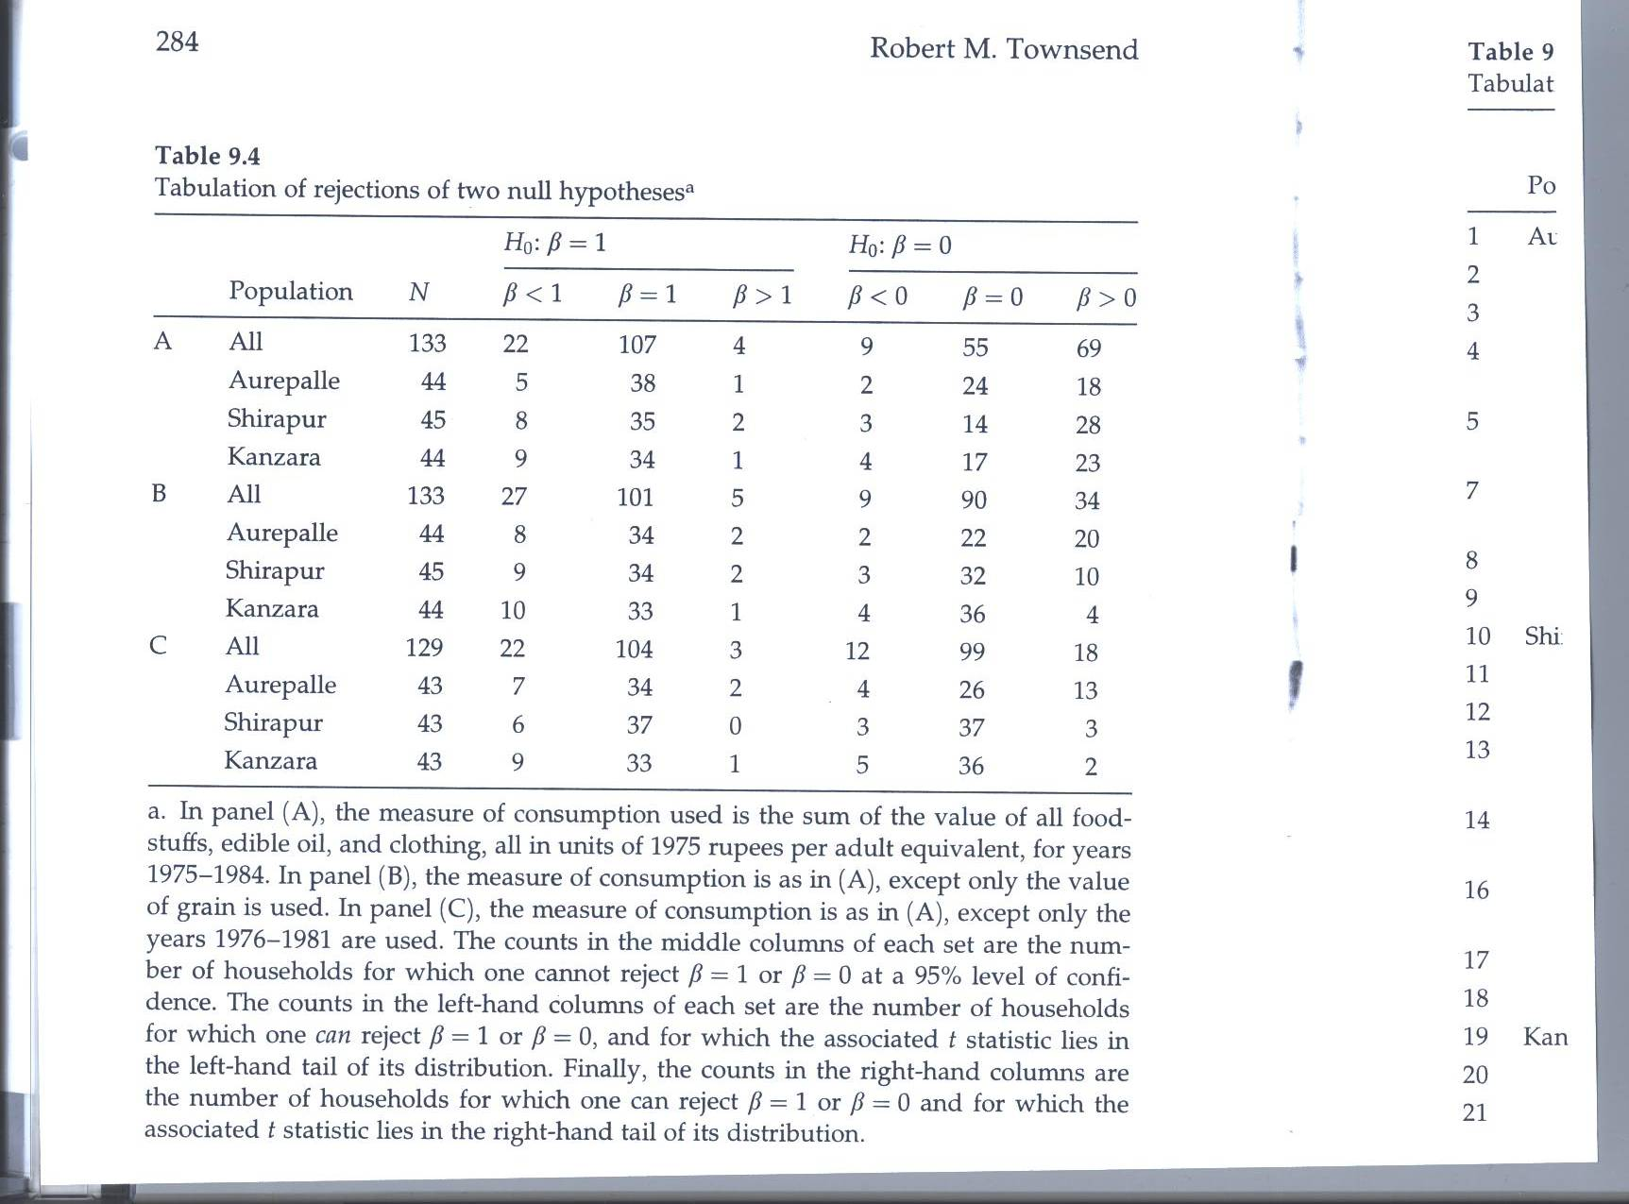

Slide 33
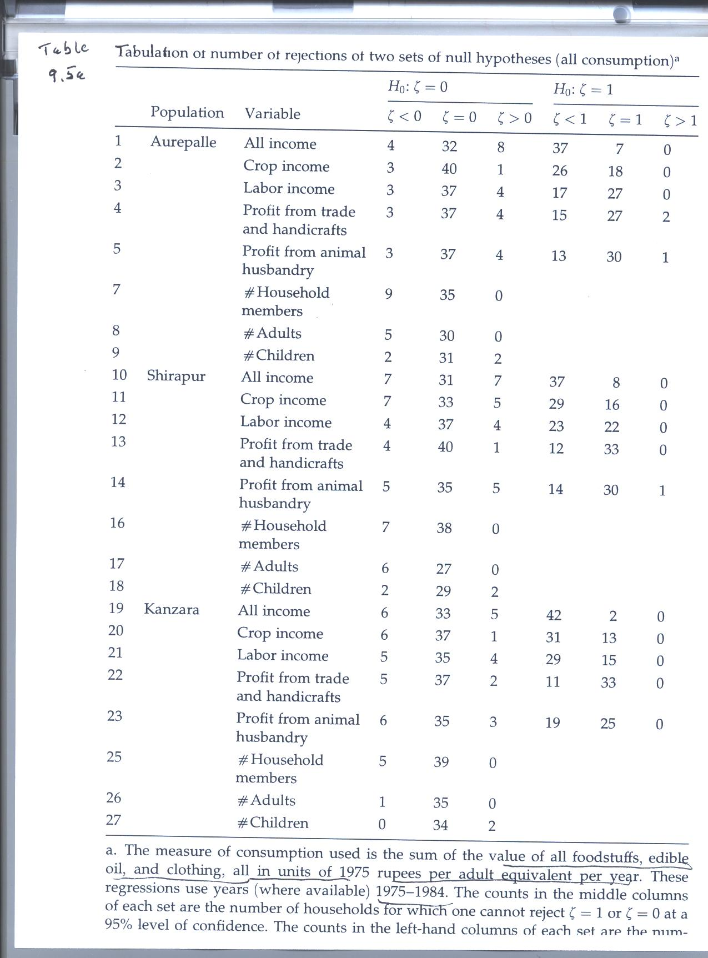

Slide 34
While most seem to be insured against income shocks, who is not?
Landless and small farmers in Aurepalle, small and medium farmers in Shirapur, medium and large farmers in Kanzara
This is shown in Table 9.6

Slide 35
Panel Estimates: Pooling across hhs and over time for each village
Subtract average cons from each side of equation to
Also add some explanatory variables
Tables 9.8 a, b and c present panel estimates in levels (Panel A) and first differences (Panel B) and two-instrument IV (Panel C) which allows estimates to be consistent despite measurement error, separately for each consumption measure
If a, b differ, it may indicate measurement error in RHS variables
Note that few of these various income and other measures are statistically significant, mainly the demographic variables

Slide 36
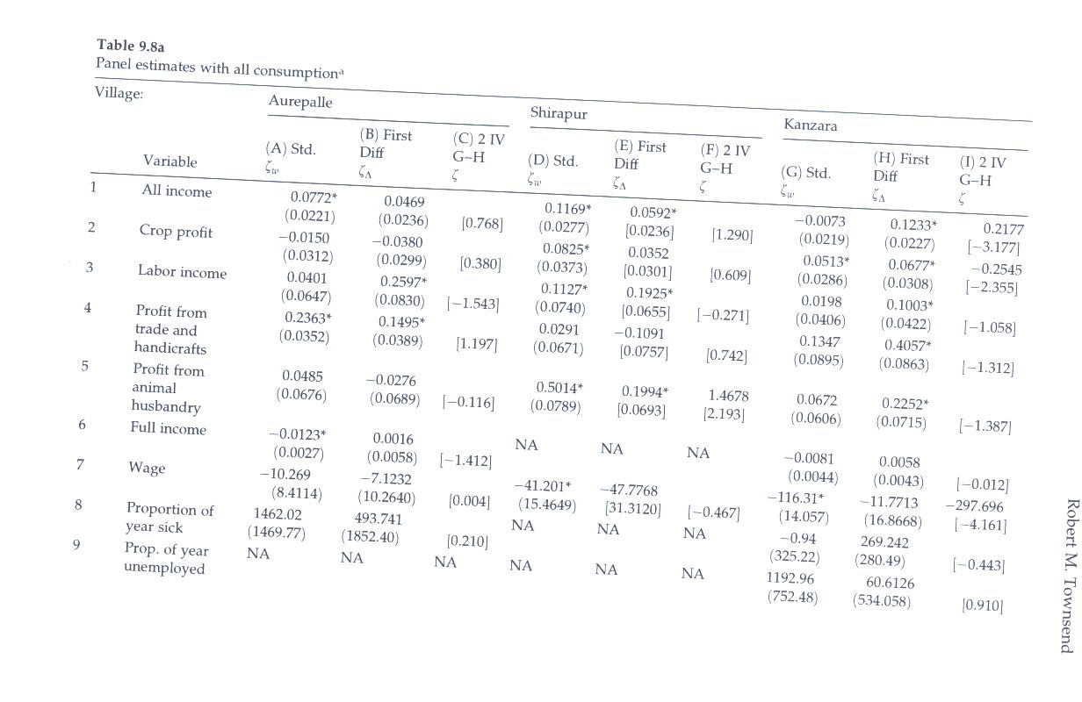

Slide 37
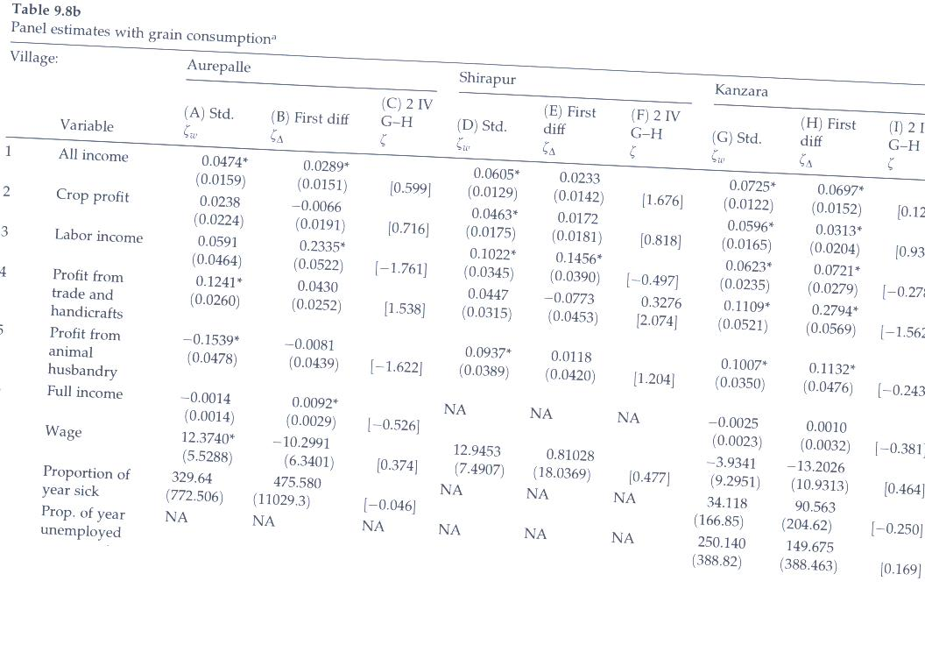

Slide 38
Joint Significance tests for Income variables
Table 9.9 a, b for total cons, grain consumption respectively show that these are not collectively significant

Slide 39
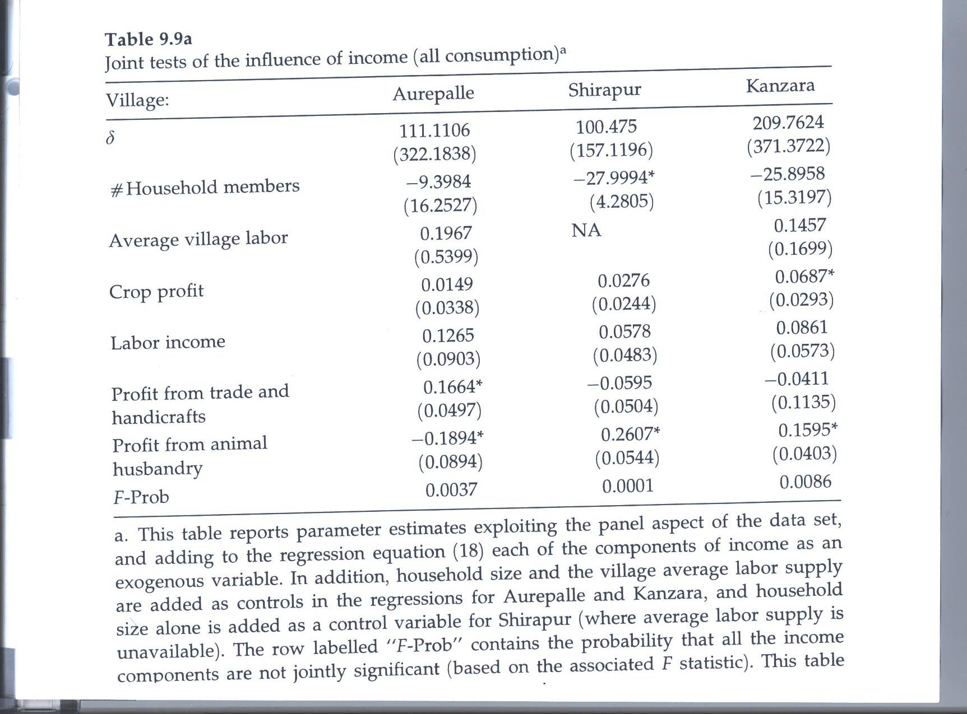

Slide 40
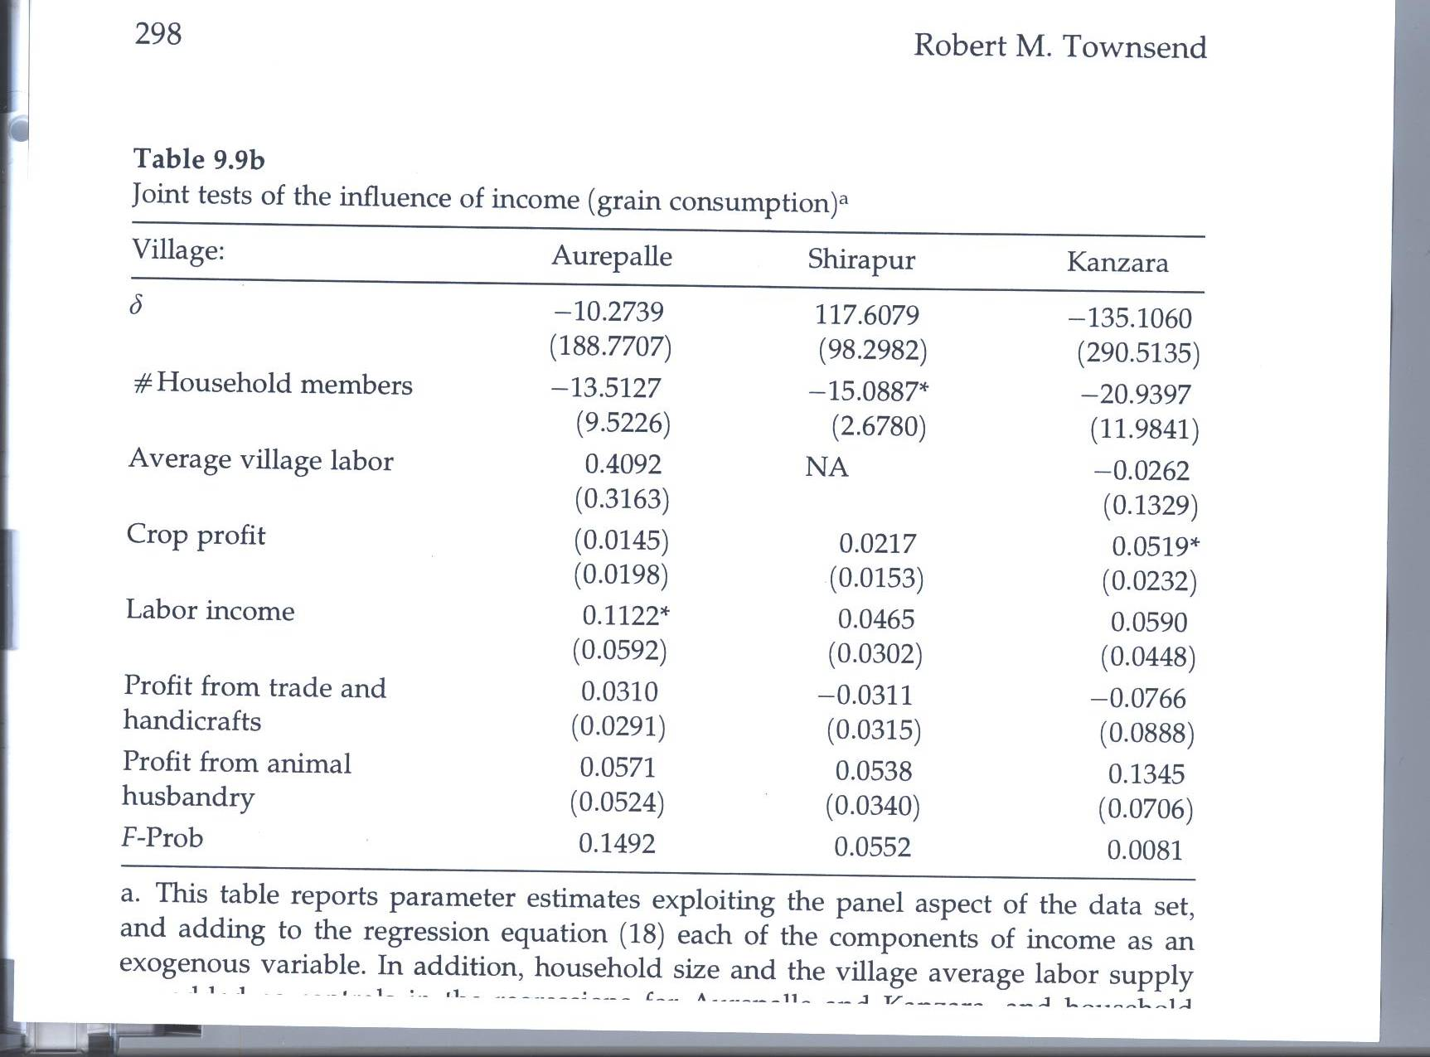

Slide 41
Again, who is not insured?
Tables 9.10a,b
  These investigate effects of landholding status on the pattern of β,ξ estimates when consumption is measured by total consumption and grain consumption
  Insurance works less well for landless in all villages

Slide 42
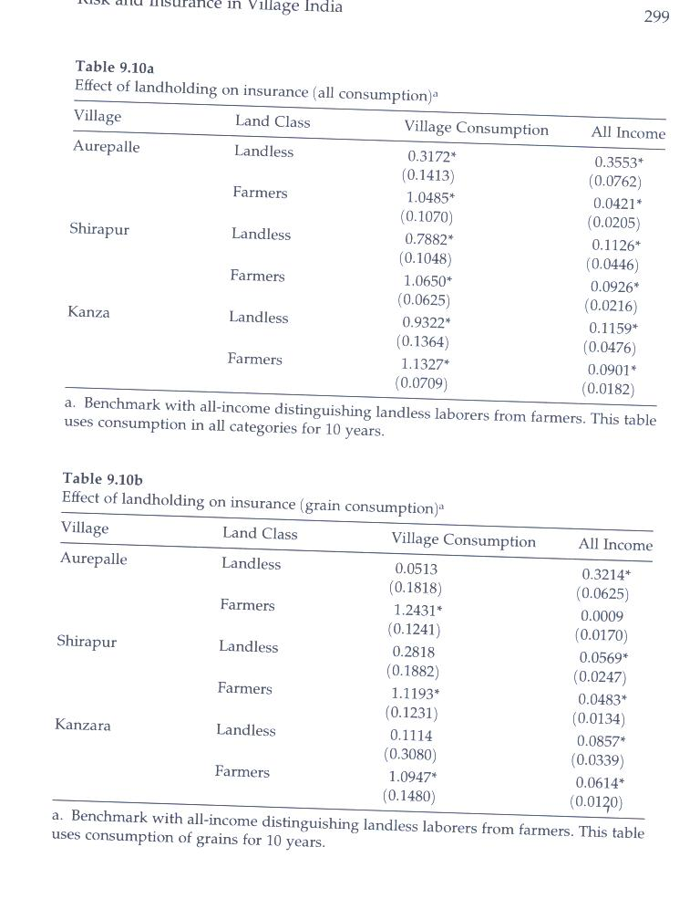

Slide 43
Could the explanation be permanent instead of current income?
But neither past income nor wealth measures seem to do any better than current income in explaining consumption
Table 9.11a,b does show that total wealth is usually significant and bullocks in Kanzara
Also shows that splitting period into two to show the effect of acquired wealth or capital does not matter, nor age of head, outmigrants, etc.

Slide 44
Altruism and comparable studies in US.
Examine Allocation of consumption across intergenerational hhs.
But full insurance rarely supported 1990 and this study show
But with ICRISAT data, both Morduch and this study . Best natural wealth variable (inheritance does not have much impact on consumption.

Slide 45
Rarely is complete markets hypothesis supported
Exception: Altug and Miller (1990) with US PSID data
Do different villages co-move? Attempts with ICRISAT data provide at best weak evidence of this.
Rashid 1990 for Pakistan showed that village incomes had greater influence on neighboring village consumption than at provincial level. Transitory components of income have no effect on consumption.

